Slide 1
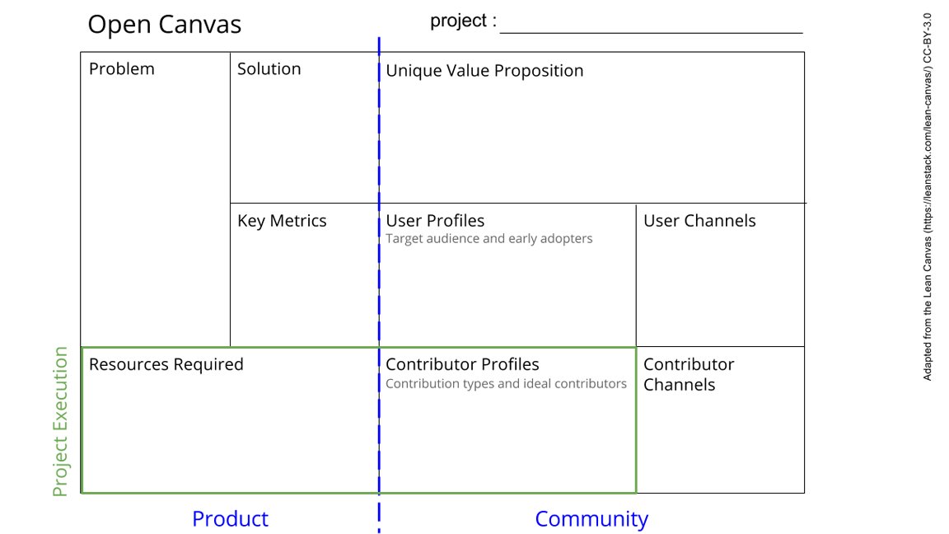
This is a template. Please make a copy for yourself (file -> Make a copy).
See next slide for instructions!
Notes:
Go to File > Make a Copy… to make your own canvas
See next slide for instructions

Slide 2
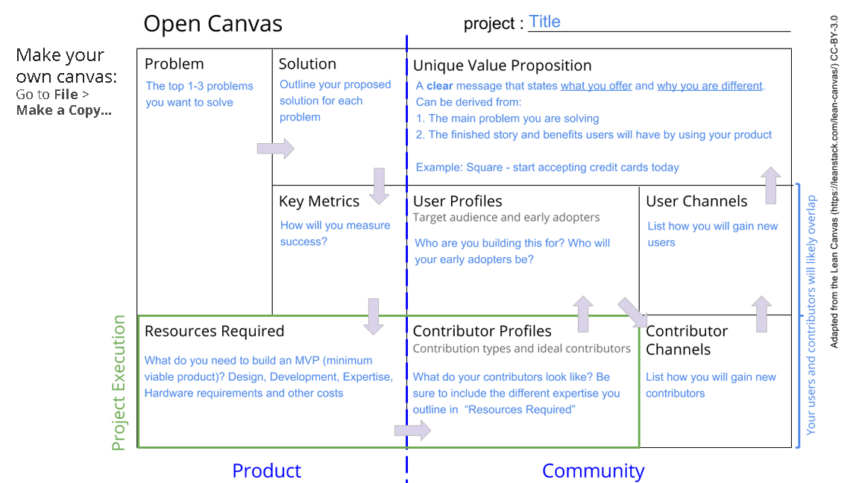

Slide 3
Breast Cancer Prediction Project
Africa has one of the highest breast cancer death rates. The women who die of this disease are more more younger and go to the hospital at a too late stage of the disease. Anti-cancer examinations are not yet accessible to everyone.
A rapid, affordable, low-cost and accessible screening test to all women.
Develop an algorithm that efficiently and effictively predit early breast cancer.
Reduction in mortality among women due to breast Cancer.
Increase in the number of tested women
And Decrease of the mortality due to breast Cancer
Communication is the key to attract new users and to motivate women to be tested.
Medical practitioners, oncologists, Regulators, Hospitals..
This is an example to help you understand how you can create an open canvas for your project
Data,
Computer power
Internet
3 D printer
Electricity
Biologists, Data scientists, Electromechanicians.
Collaborations through existing networks of scientists.
Notes:
Go to File > Make a Copy… to make your own canvas
See next slide for instructions

